Slide 1
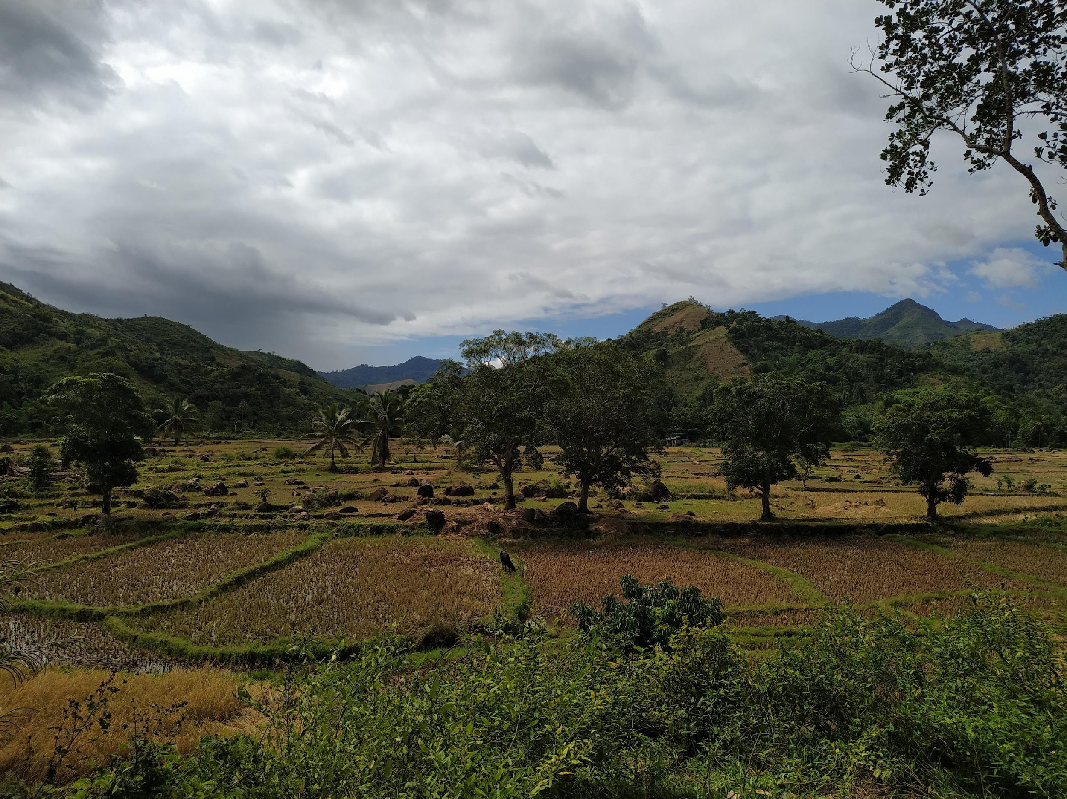
Distinct drivers of host-microbe network structures for core and rare microbes along a land use change gradient
Matan Markfeld, Georgia Titcomb, Charles Nunn, Shai Pilosof
September, 2024

Slide 2
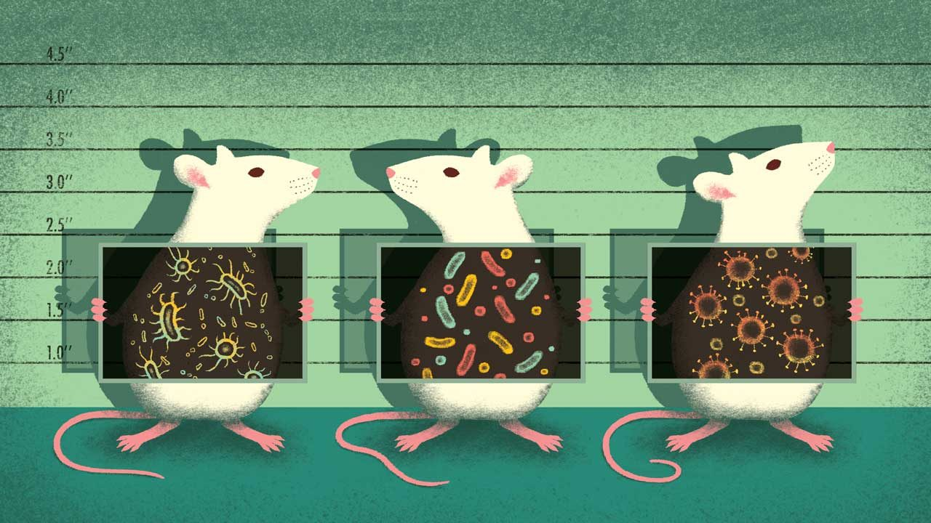
The microbiome is crucial for host health and function
It is important to understand the processes and factors that shape the microbiome
Berg et. al., 2020; Rosenberg & Zilber-Rosenberg, 2018
Notes:
the microbiome is crucial for the host health and function. Changes to the microbiome might change the host’s function and make it more susceptible to disease, for example.
Affecting disease.. specifically in rodents that are an important reservoir of zoonotic disease agents.
Therefore, it is important to understand the processes and factors that shape the microbiome.

Slide 3
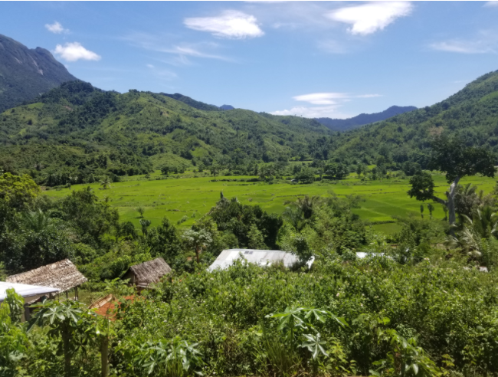
Land use change
Forest
Agriculture
Village
Host Microbiome
Newbold et. al., 2015; Bernardo-Carvo et. al., 2020; Fackelmann et. al., 2021
Notes:
Anthropogenic land use change, including the conversion of natural areas to agricultural or urban ecosystems, alters the environment and the conditions in which the host microbiome is shaped.

Slide 4
Land use change
Forest
Agriculture
Host community change
Village
Host Microbiome
Newbold et. al., 2015; Bernardo-Carvo et. al., 2020; Fackelmann et. al., 2021
Notes:
land use change can alter the host microbiome in different ways. It changes the host community composition and abundance, which can affect the transmission of microbes between hosts.

Slide 5
Land use change
Forest
Agriculture
Host community change
Human-Wildlife interface
Village
Diet shift
Host Microbiome
Newbold et. al., 2015; Bernardo-Carvo et. al., 2020; Fackelmann et. al., 2021
Notes:
Additionally, Human-wildlife interface is changed with agricultural practices. This can lead to diet shift of the host and to changes in the gut conditions.
and of course, that also can expose animals to human microbes and pathogens.

Slide 6
Land use change
Forest
Agriculture
Host community change
Human-Wildlife interface
Village
Diet shift
Neutral processes
Host Microbiome
Selective processes

Slide 7
Core and non-core microbiome
Functional roles may vary between microbial groups
Different processes at different scales may drive the distribution of different groups of microbes

Slide 8

While most microbiome research focuses on humans or domestic animals, we still don’t know a lot about wild animals and how environmental factors, such as land use change, affect their microbiome
Assessing the effect of land use change on the microbial community is challenging, as the landscape is continuous and not discrete, presenting high heterogeneity within each land use and across land uses
Notes:
However, while most moicrobiome research focuses on humans or domestic animals, we still don’t know a lot about wild animals and how environmental factors, such as land use change, affect their microbiome.

Slide 9
We can explore the host-microbe network structure
The network’s structure is a signature of the processes that shaped the network
The network captures the heterogeneity within and between land uses
Microbes
Hosts
Agroforest
Rice
Forest

Slide 10
Research questions
Q1. What processes shape host-microbe community structures along a land use change gradient?
Q2. How do core and rare microbial groups differ in these processes?

Slide 11
Hypotheses
H1. Neutral processes
H2. Processes at the local scale (within land use)
H3. Processes at the land use scale
H4. Interaction between microbial group and H1-3

Slide 12
Filtering the microbiome
Rattus from 3 villages
Feces – gut microbiome
Bacteria ASVs
Relative reads abundance > 0.1% per sample
Prevalence > 1%
Total reads in a sample > 5000
Taxonomy

Slide 13
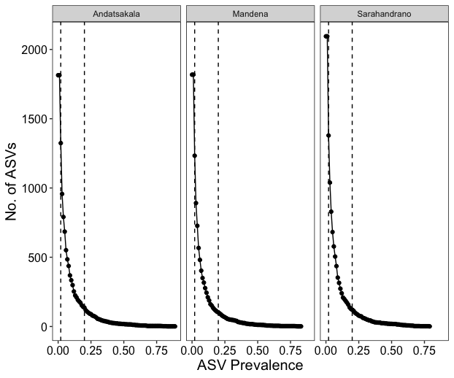
Microbes' prevalence
3 groups:
Rare [1%-2%]
Non-core [2%-20%]
Core [>20%]

Slide 14
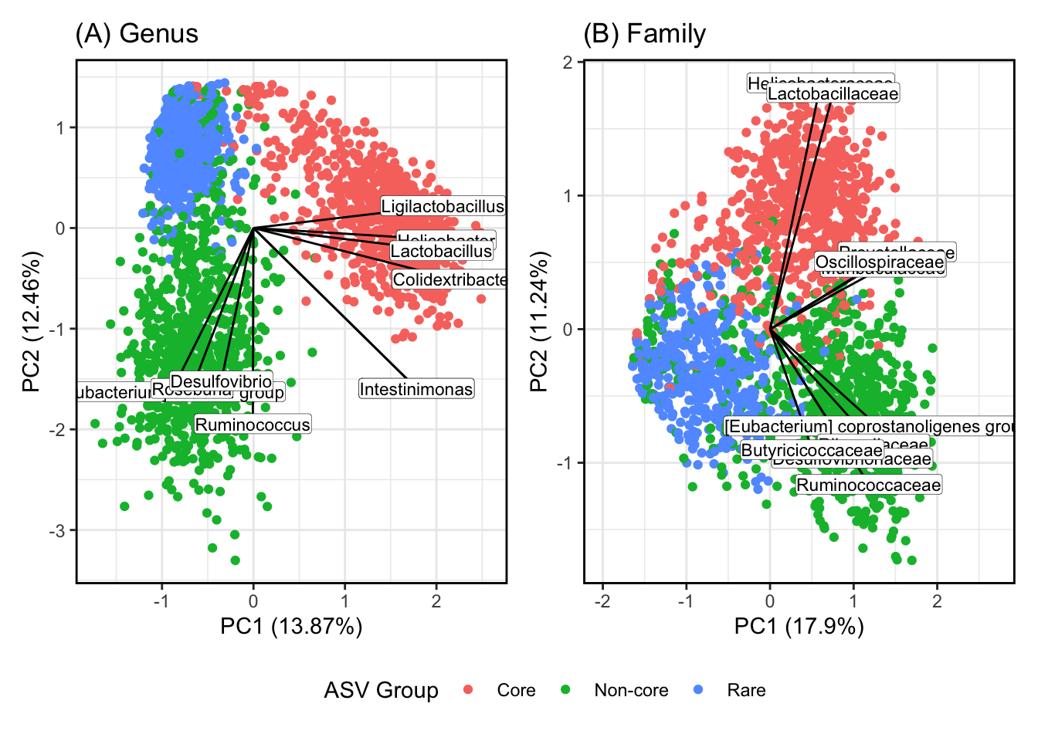
The groups represent different microbial genera (and potentially functions)

Slide 15
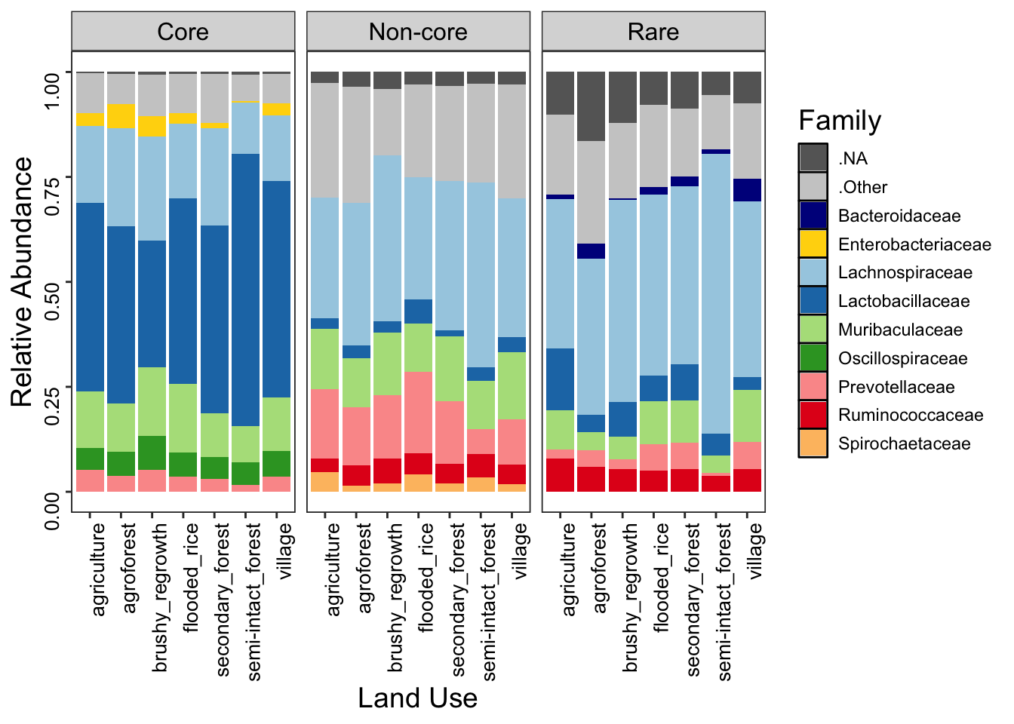
Family relative abundance

Slide 16
Bipartite network between host individuals and bacteria ASVs
Link’s weight = ASV relative abundance
Infomap
Microbes
Hosts
Agroforest
Rice
Forest

Slide 17
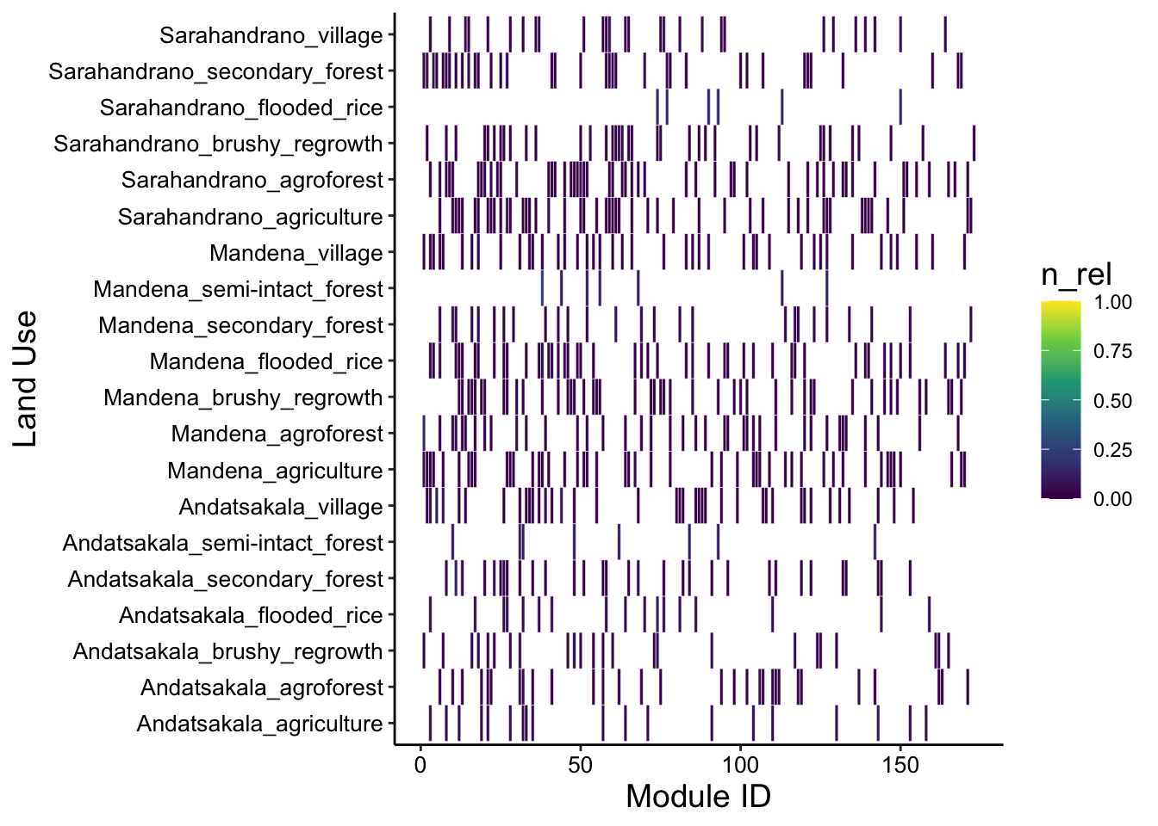
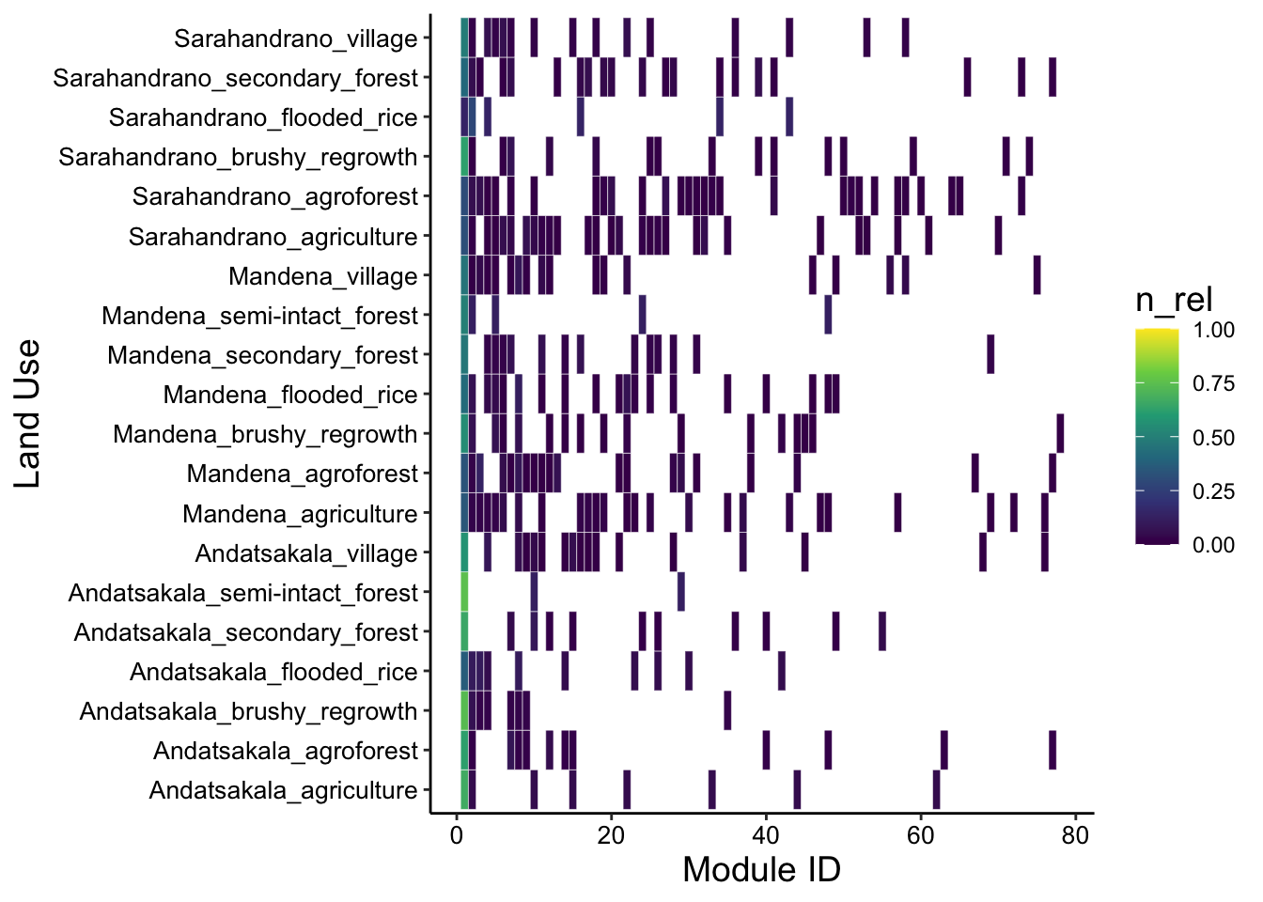
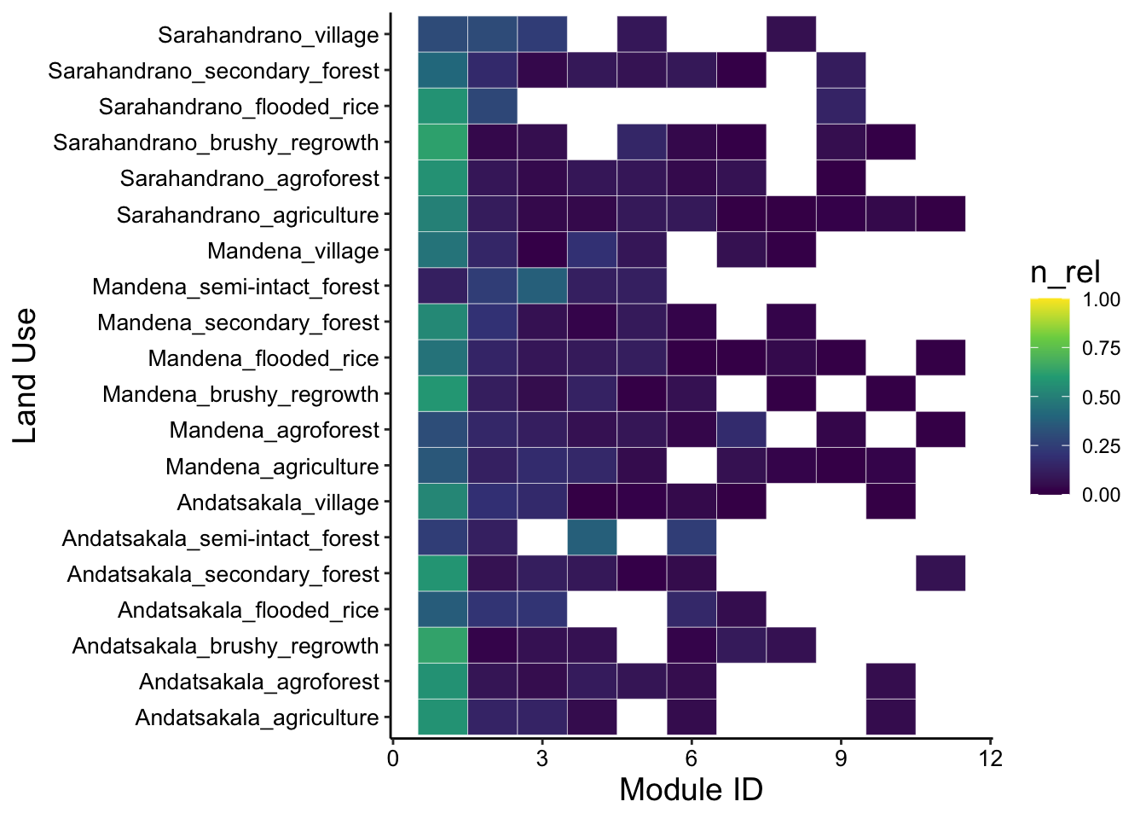
Community detection - Infomap
Rare
Non-core
Core

Slide 18
What does this modular structure tell us about the processes that shaped the network?
Beta-NTI (Nearest Taxon Index)
Measures phylogenetic turnover compared to the turnover expected by chance
Raup-Crick
Measures turnover compared to the turnover expected by chance
Stegen et. al., 2012; Zhou & Ning, 2017
Notes:
To answer my question we need first to connect between the structure and the processes.

Slide 19
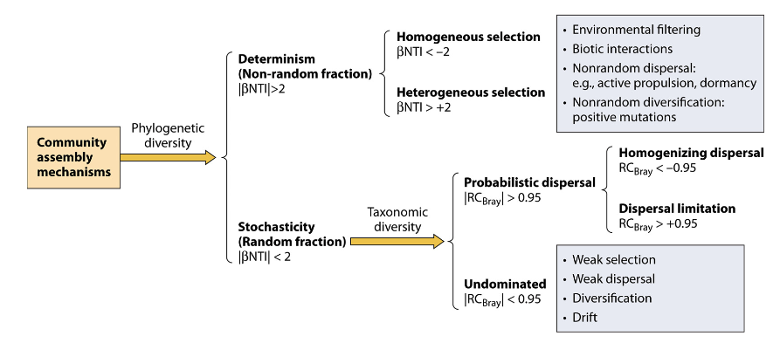
What does this modular structure tell us about the processes that shaped the network?
Stegen et. al., 2012; Zhou & Ning, 2017
Notes:
To answer my question we need first to connect between the structure and the processes.

Slide 20
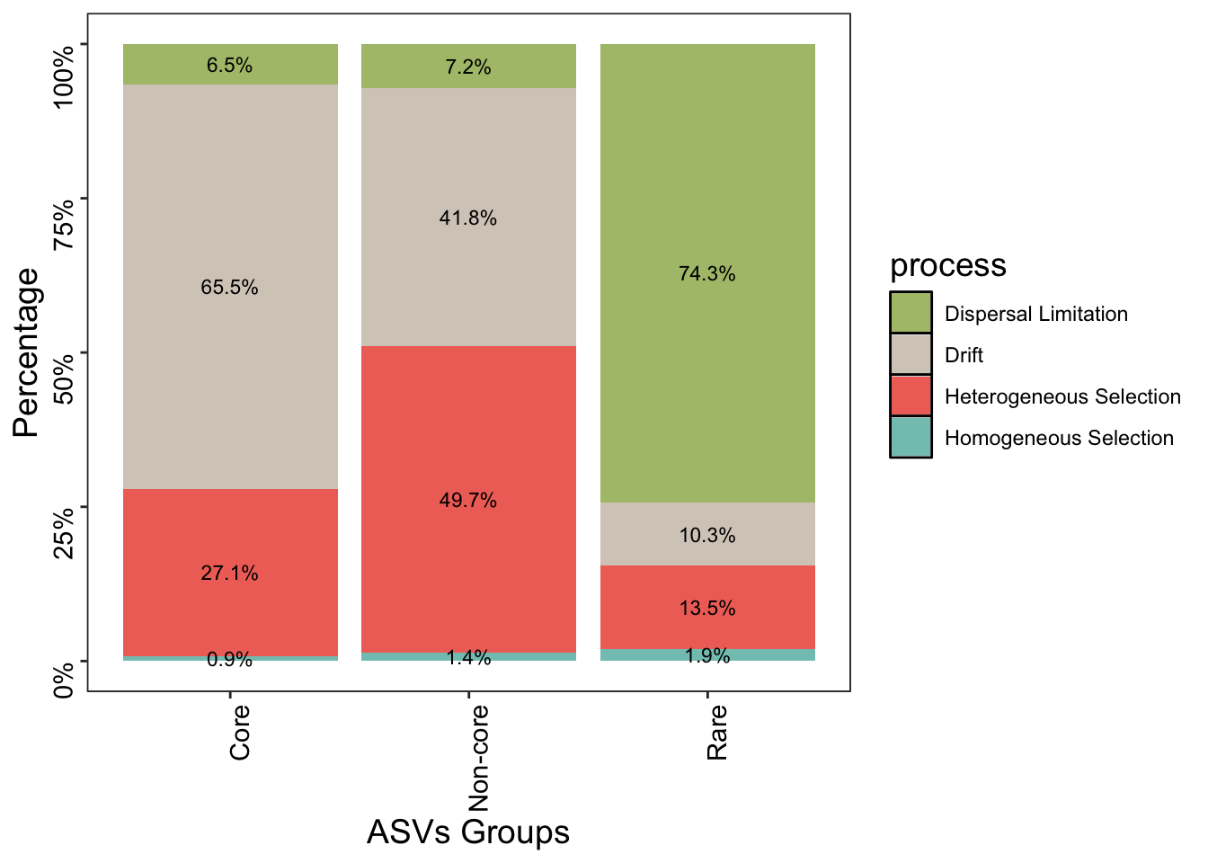
Distinct processes for prevalence groups

Slide 21
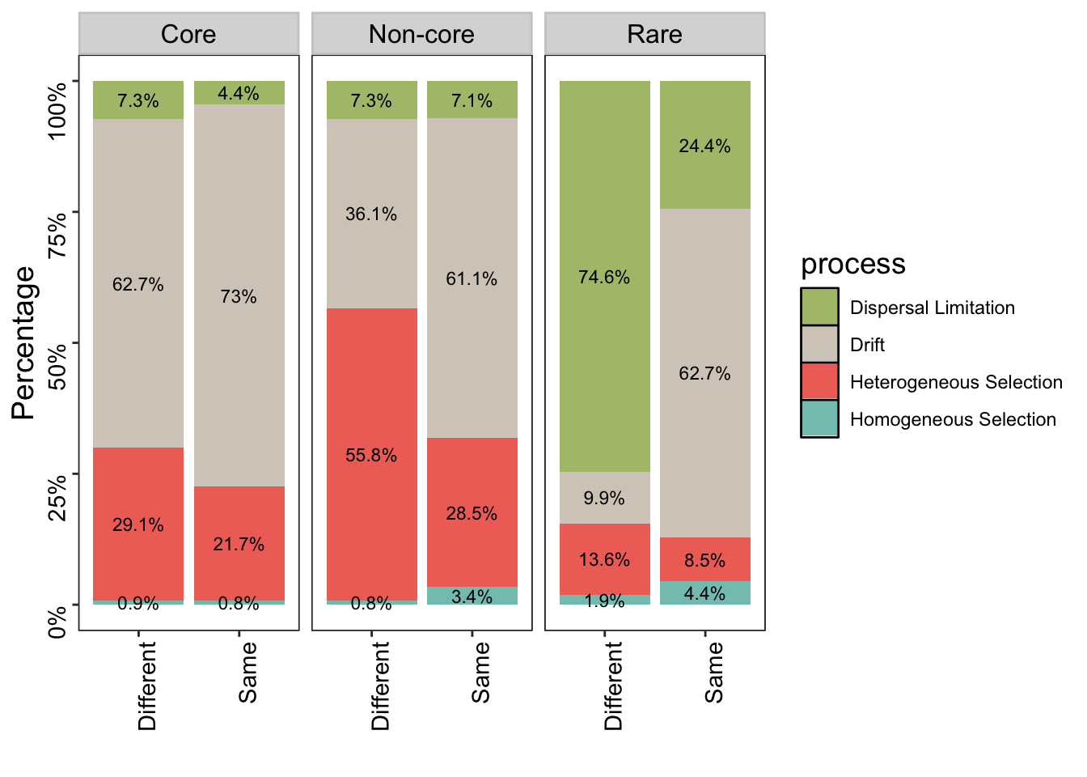
Network’s modules are indicative of the processes
Rare
The modules capture microbe turnover due to dispersal limitation between hosts
Neutral processes dominate the variation between hosts clustered in the same module

Slide 22
Network’s modules are indicative of the processes
Non-core
The modules capture selective differences between hosts
Neutral processes dominate the variation between hosts clustered in the same module

Slide 23
Network’s modules are indicative of the processes
Core
Neutral processes dominate the variation between hosts clustered in same and different modules

Slide 24
Q1. What processes shape host-microbe community structures along a land use change gradient?

Slide 25
Normalized Mutual Information (NMI)
NMI = 1
NMI = 0
 | LU1 | LU2 | LU3 | LU4 | LU5
Group 1 | 10
Group 2 |  | 10
Group 3 |  |  | 10
Group 4 |  |  |  | 10
Group 5 |  |  |  |  | 10
H1
 | LU1 | LU2 | LU3 | LU4 | LU5
Group 1 | 50
 | LU1 | LU2 | LU3 | LU4 | LU5
Group 1 | 2 | 2 | 2 | 2 | 2
Group 2 | 2 | 2 | 2 | 2 | 2
Group 3 | 2 | 2 | 2 | 2 | 2
Group 4 | 2 | 2 | 2 | 2 | 2
Group 5 | 2 | 2 | 2 | 2 | 2
H2
H3
Taya et. al., 2016
Notes:
to measure the degree of agreement between the hosts' land use and the hosts' modules.

Slide 26
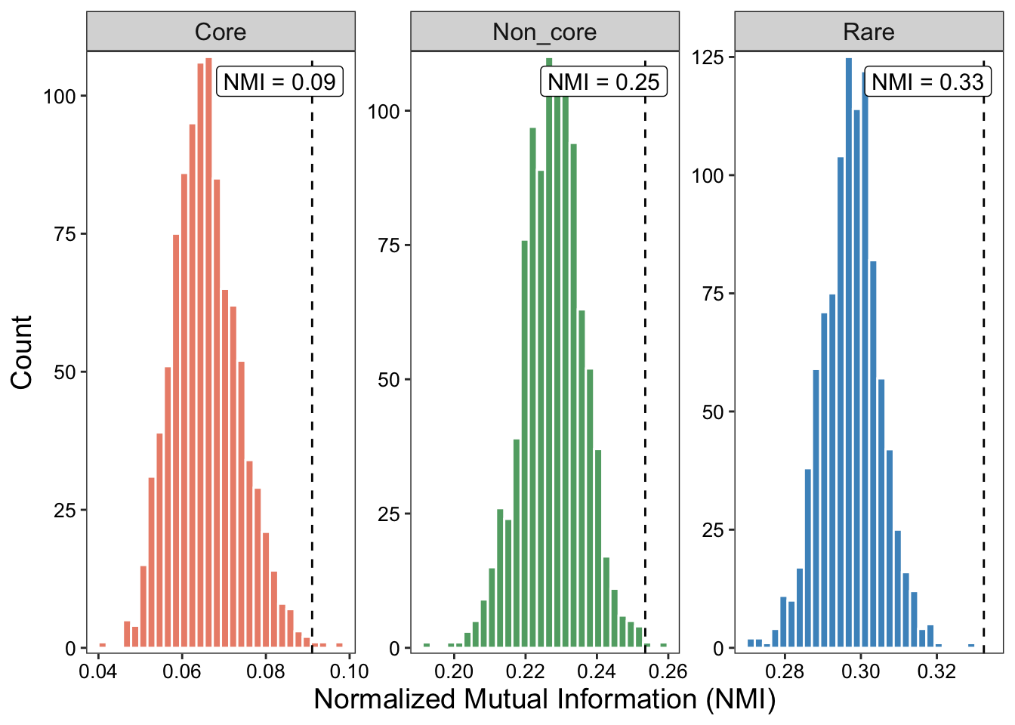

Slide 27
Q1.2. How does the composition of modules vary across land use change gradient?
H2 + H3

Slide 28
Environmental gradients explain modules variation for Non-core and Rare groups

Slide 29
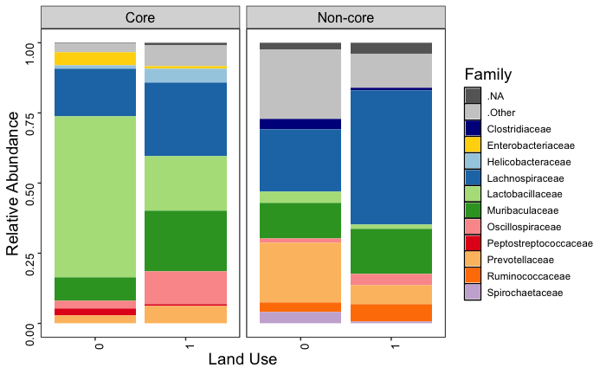
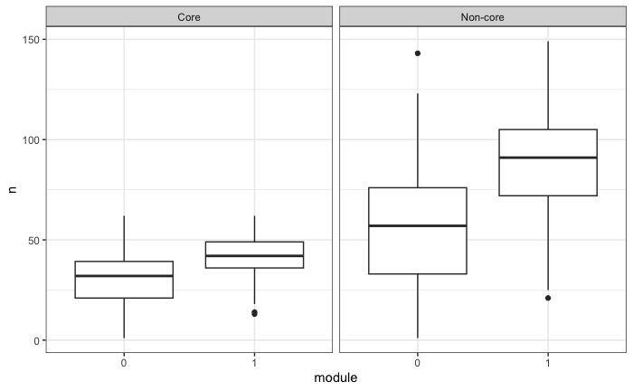
The big module has different microbiome

Slide 30
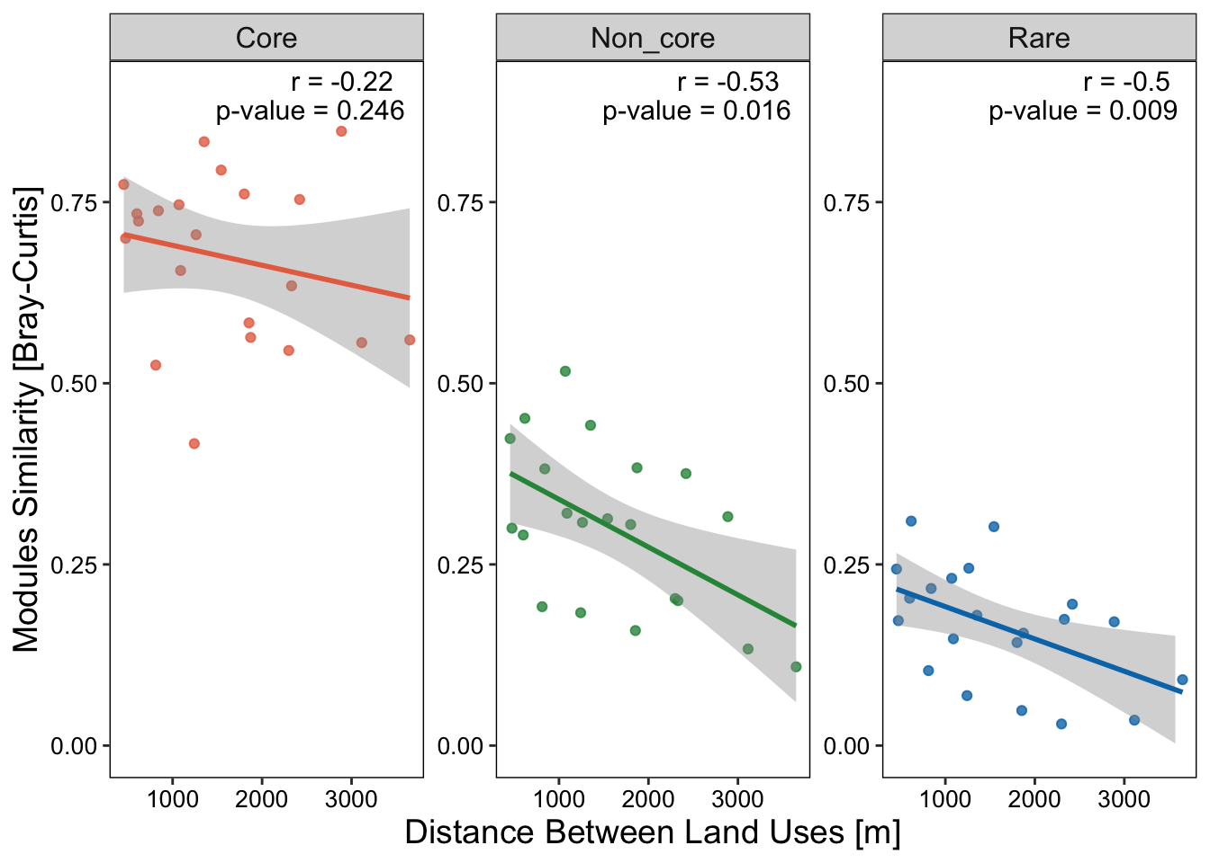
Land uses farther apart show lower similarity in modules only for rare and non-core

Slide 31
Summary
Core microbes are more consistence across land use
Non-core and Rare microbes are gradually changed along land use change gradient - Non-core – selective process (environmental filtering) - Rare – dispersal limitation

Slide 32
Summary
A combination of neutral and selective processes shape the host microbiome
The system is mostly neutral (stochastic)
Land use change alters the environment heterogeneity and induces gradual selective pressures
The selective impact within and across land use is driven by rare microbes that clustered in small modules associated to specific land uses

Slide 33
Q3. Can we predict links in the network?
Q3.1. What are the important features in the prediction?
Random forest
Features: degree, hosts’ variables, land use variables

Slide 34
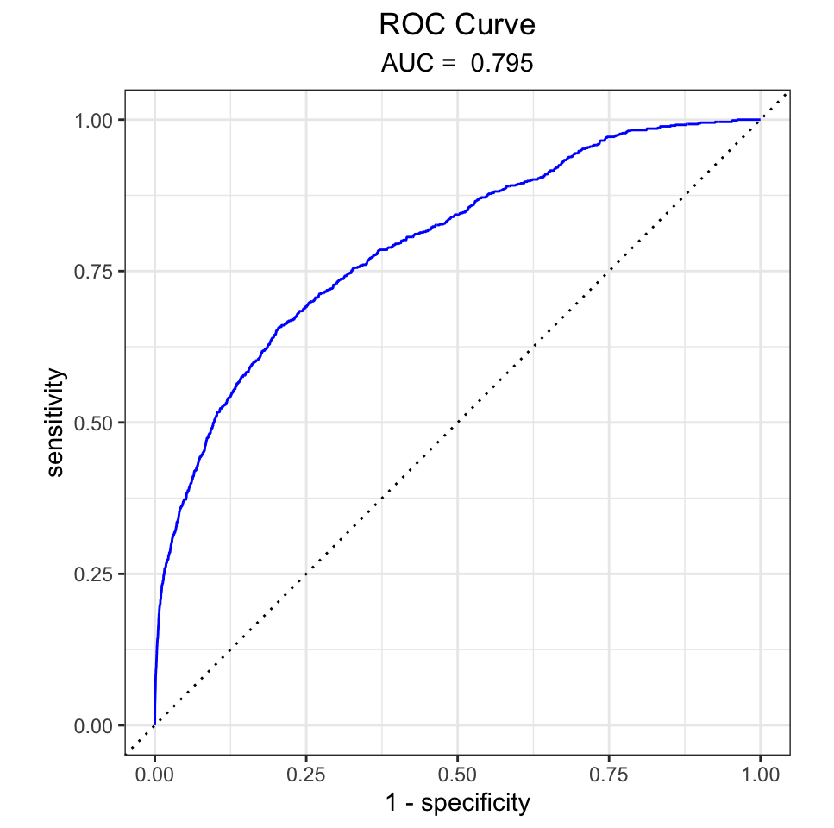
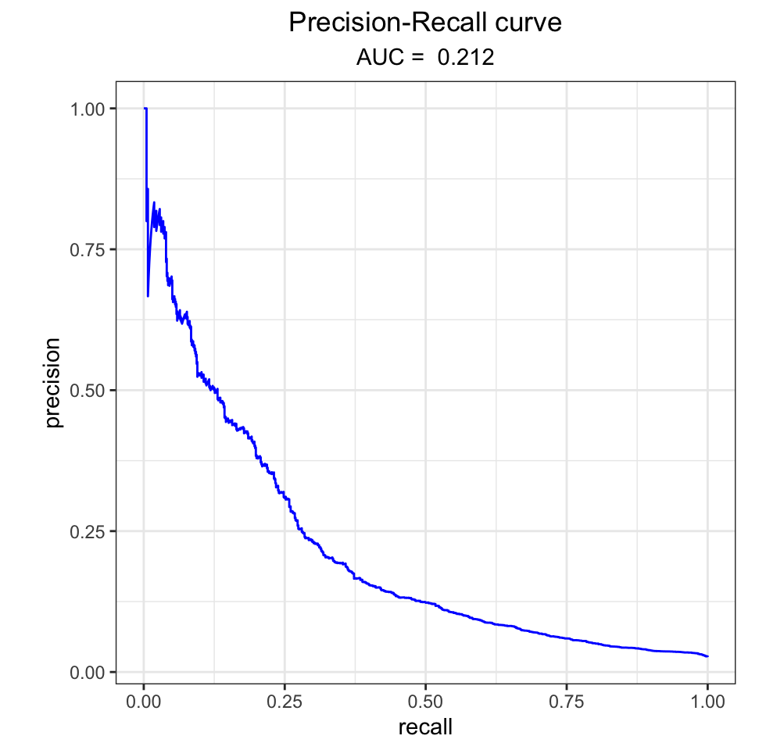
Link prediction
Accuracy = 0.974
Precision = 0.661
Recall = 0.055
F1 = 0.102

Slide 35
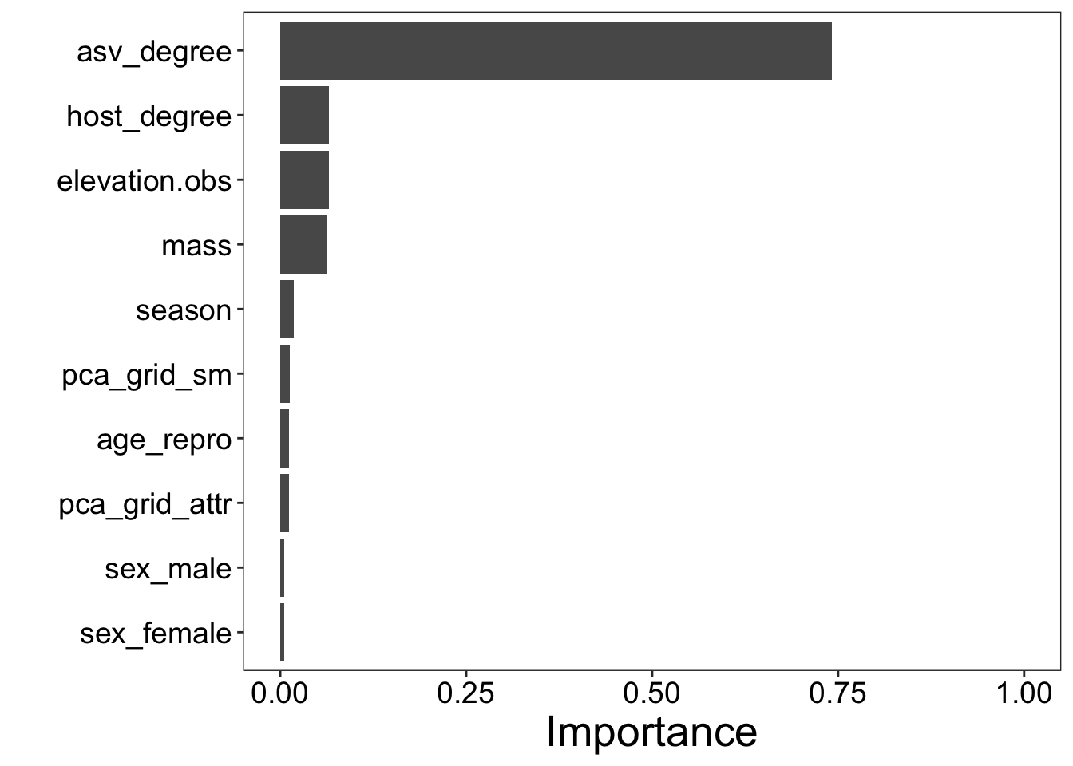
Link prediction – Features importance

Slide 36
Land use change
Human-Wildlife interface
Host community change
Vegetation change
Environment species pool
Diet shift
Host dispersal
Host Microbiome

